Slide 1
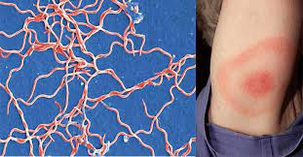
Borrelia
Dr. Bincy Joseph
Assistant professor
PGIVER, Jaipur

Slide 2
Genus: Borrelia
Borrelia anserina: Avian spirochaetosis
Borrelia theileri: Tick borne fever
Borrelia burgdorferi: Lyme disease in human being

Slide 3
Avian spirochaetosis
Borrelia anserina is transmitted by soft tick of poultry : Arguss persicuss
The organism are cultivated by yolk sac route in chicken embryo/ or intra peritoneal route in newly hatched chicks
Symptoms : fever anorexia, depression, greenish diarrhoea and mortality 100%
Lesion: haemorrhagic carcass, spleenomegaly, hepatomegaly and focal necrotic lesions in liver

Slide 4
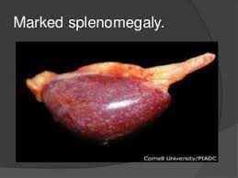
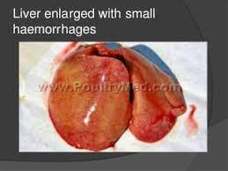
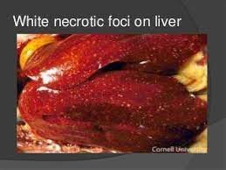

Slide 5
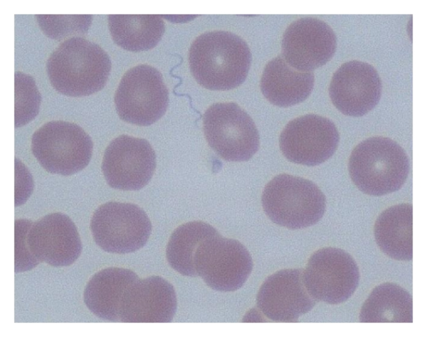
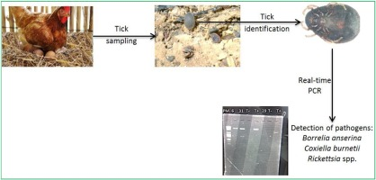
Diagnosis
Direct examination of blood using Giemsa stain
Isolation and identification using yolk sac inoculation

Slide 6
Spirillum minus: rat bite fever
Treponema pallidum: Syphilis in human being
Treponema cuniculi: rabbit syphilis

Slide 7
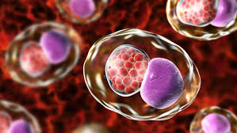
Genus chlamydia

Slide 8
Genus chlamydia
Organisms are obligate intracellular bacteria with unusual developmental cycle during which infectious form produced
They replicate within a non-acidified,
cytoplasmic vacuole in eukaryotic host cells
On account of their inability to generate ATP , they are called energy parasites
Two genus in the Family Chlamydiaceae
Genus Chlamydia
Genus Chalmydophila
Genus Chlamydia also known asTtrachoma Inclusion Conjuctivitis Agent or PLV agent/Psittacosis Lymphogranuloma Venereum/ Bedsonia agent

Slide 9
Chlamydia
Chlamydia trachomatis
Chlamydia suis
Chlamydia muridarum
Chlamydophila
Chlamydophila psittaci
Chlamydophila abortus
Chlamydophila felis
Chlamydophila caviae
Chlamydophila pneumoniae
Chlamydophila pecorum

Slide 10
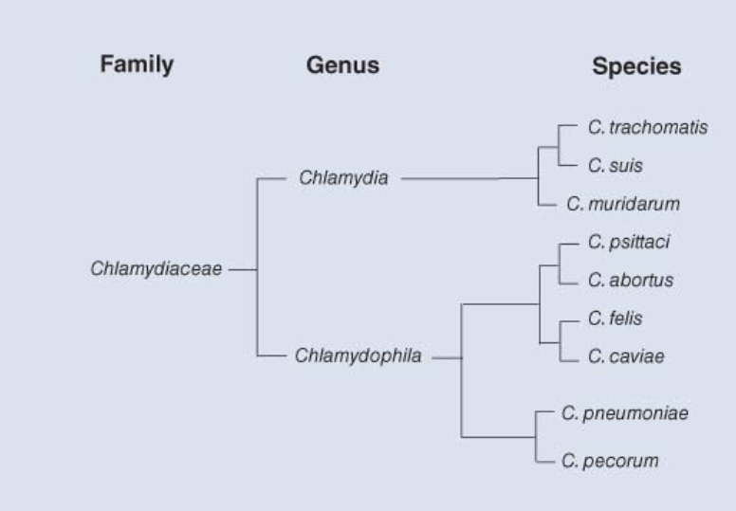

Slide 11
Morphology: organism are Gram negative but cell wall lacks N acetyl muramic acid
In the developmental cycle two forms
Infectious and reproductive form
These two forms are distinct morphologically
Infectious extracelluar form are called elementary bodies (EB), very small bodies with 200-300nm size
They are metabolically inert and osmotically stable
Each elementary body is sorrounded by a conventional bacterial cytoplasmic membrane, periplasmic space and an outer envelope with LPS
The periplasmic space does not contain a detectable peptidoglycan layer and the EB relies on disulphide cross-linked envelope proteins for osmotic stability

Slide 12
Elementary body enter host cell by receptor mediated endocytosis and the process of structural reorganisation converts elementary body into reticulate body
Reticulate body also known as initial body and is about 1μm (1000nm) in diameter
They are large metabolically active and osmotically fragile
Reticulate body replicates by binary fission within the vacuole
The vacuole and its contents, when stained,
are called an inclusion
When a number of inclusions containing RBs of C. trachomatis are formed in an infected cell, fusion of these structures may occur
About 20 hours after infection, the developmental cycle becomes asynchronous, with some RBs continuing to divide and remaining in
close association with the inclusion membrane while others detach from the inclusion membrane, condense and mature to form EBs
In general, replication continues for up to 72 hours after infection
when the host cell lyses releasing several hundred bodies which include EBs, RBs and intermediate forms.

Slide 13
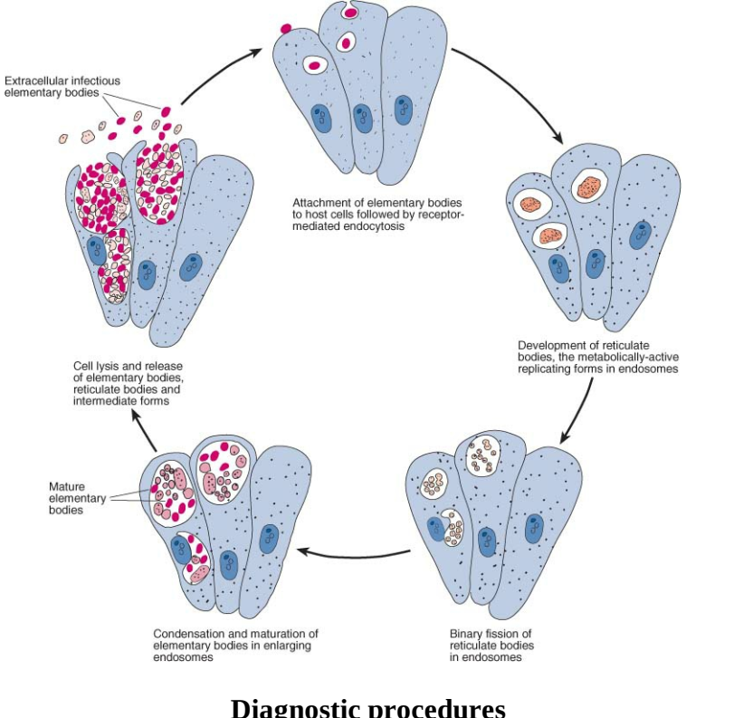

Slide 14
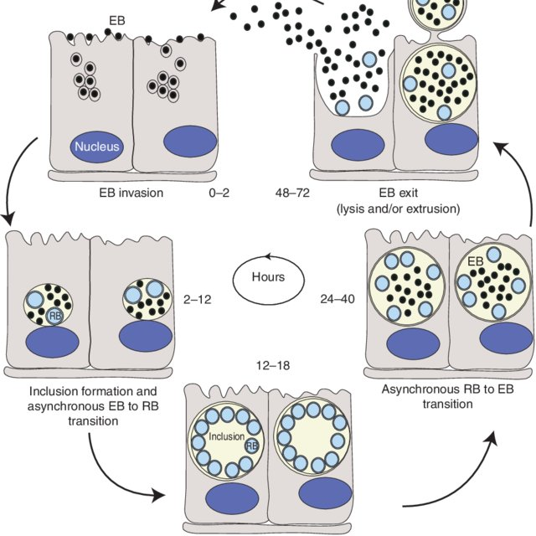
Life cycle of chlamydia

Slide 15
Chalmydial organism can agglutinate mouse hamster RBC both at 22ºC and 37ºC.
Organisms are sensitive to penicillin, tetracyclin and chloramphenicol
Cultivation
Since energy parasite require a living media for culture
Embryonated chicken egg is used through yolk sac inoculation by 5-7 days of age
After inoculation death by 6-10 days.
Important lesions are patchy haemorrhagic lesions in embryo, severe congestion of yolk sac vessels

Slide 16
I/p inoculation in mice and guinea pig indicated by death of mice or by rise in antibody titre
Cultivation in cell culture
Cellines such as McCoy, L929 , Vero, BHK-21
The sensitivity of the isolation procedure is also increased by the use of non-replicating cells.
This is achieved by the addition of cytotoxic chemicals such as cycloheximide, 5-iodo-2-deoxyuridine, cytochalasin B and emetine to the cell culture medium
Antibiotics to which chlamydiae are sensitive, such as xytetracycline, erythromycin and penicillin, should not be used in the cell culture medium.
Attachment of chlamydia to the cell is greatly enhanced by centrifugation of the sample onto monolayer
Sensitivity of isolation procedure enhanced by adding cycloheximide
After inoculation in cell culture growth of organism is determined by cytopathic effect and demonstration of inclusion bodies

Slide 17
Staining reactions
All these for elemetary and reticulate bodies of Chlamydia
Modified Ziehl Neelsen staining
Castaneda staining
The EB appear as blue and RB appear as red in Castaneda staining
Geiminez staining
The elementary bodies appear as red bodies and reticulate bodies appear as green in blue background in Macchiavella Giemenaz staining,
Methylene blue staining
Giemsa stainig
Elementary bodies appear as reddish purple bodies and RB appear in blue color

Slide 18
antigens
Genus specific glycolipid
Species specific polypeptide and haemagglutinin

Slide 19
pathogenicity
Orgainsm are seen in respitratory tract and intestinal tract of animals and birds
Infection occur by ingestion, inhalation, vector transmission and egg transmission
Most important organism is Chlamydia trachomatis: affecting human being
It causes trachoma, inclusion body conjuctivitis and respiratory difficulties in infants
Also causes lymphogranuloma venerum and arthritis

Slide 20
Chlamydia suis causes intestinal infection in pigs
Chlamydia muridarium : respiraotory infection in mouse
Chlamydophila psittaci: affects birds causing pneumonia and air saculitis, intestinal infection, diarrhoea, conjuctivitis, pericarditis and encephalitis
Disease condition caused by chlamydia psittaci in psittacine birds is called psittacosis and non psittcine bird is called ornithosis
In human being it will cause abortion and conjuctivitis

Slide 21
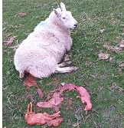
Chlamydophila abortus
Enzootic abotrion in ewes
Abortion in goats
Enzootic bovine abortion (EBA)/ foot hill abortion
In pigs: abortion
Chalmydophila felis: responsible for feline pneumoniae/ cat distemper
Chlamydophila caviae: guinea pig inclusion body conjuctivitis
Chlamydophila pecorum: in sheep intestinal infection, conjuctivitis and poly arthritis
Polyarthits condition is known as stiff lamb disease
In cattle : sporadic bovine encephalomyelitis, polyarthitis and metritis

Slide 22
Diagnosis
History
Clinical signs and lesions for tentative diagnosis
Clinical material from aborted fetus, fetal stomach contents, vaginal mucus, lung liver etc
polyarthitis synovial fluid
Conjuctivitis : conjuctival fluid
In systemic infection, lungs, liver spleen and paired serum sample
The specimen for isolation of organism should be transported in suitable transport medium such as sucrose phosphate glutamate medium supplemented with fetal calf serum, aminoglycoside antibiotic and anti fungal agents
It is supplemented with calf serum, gentamycin, novobiocin and nystatin
All sample should be stored at 4ºC and at -70ºC

Slide 23
Direct microscopic examination of organism in tissue impression smears or in tissue sections and stain with one of the staining methods
Isolation and identification of orgainsm
Serological test: for antibody detection like CFT, ELISA, indirect immunoflourescence and passive heamagglutination test
For antigen demontration (FAT and IPT)
For genome detection PCR

Slide 24
control
For control the infected material should be buried properly
The imported birds particularly the psittacine birds should be held in quarantine and they should receive tetracycline medicated feed

